Slide 1
S.N.A.C. Software - Sistema Neurale di Analisi dei Carcinomi
CNN project – Whole Slide attention maps
Candidates:
Greta Berardengo, s244278
Silvia Fornara, s244216
Elisa Wan, s241854
Andrea Grippi, s236305

Slide 2
Introduction
Creation of a software for cancer detection by using attention maps, based on Convolutional Neural Networks.
Use of whole slide images to create dataset
Areas with high probability of cancer are strongly highlighted, while areas with lower cancer probability are highlighted in a lighter shade.

Slide 3
Strategy
Crop WSI into smaller images
Remove useless crops
Train different CNN, first with 2 and then 3 classes
Create attention map on test set images
Analyze the results

Slide 4
Theory on Neural Networks
Neural Networks are a classification method based on inter-connession between neurons, through parameters called weights
Neural Networks use backpropagation algorithm for the training, on the training set.
The evaluation of performances is done on a different set of images, called test set.
There is the problem of overfitting when a large number of parameters is involved
By using CNN we avoid the overfitting; they have a 4 layers structure

Slide 5
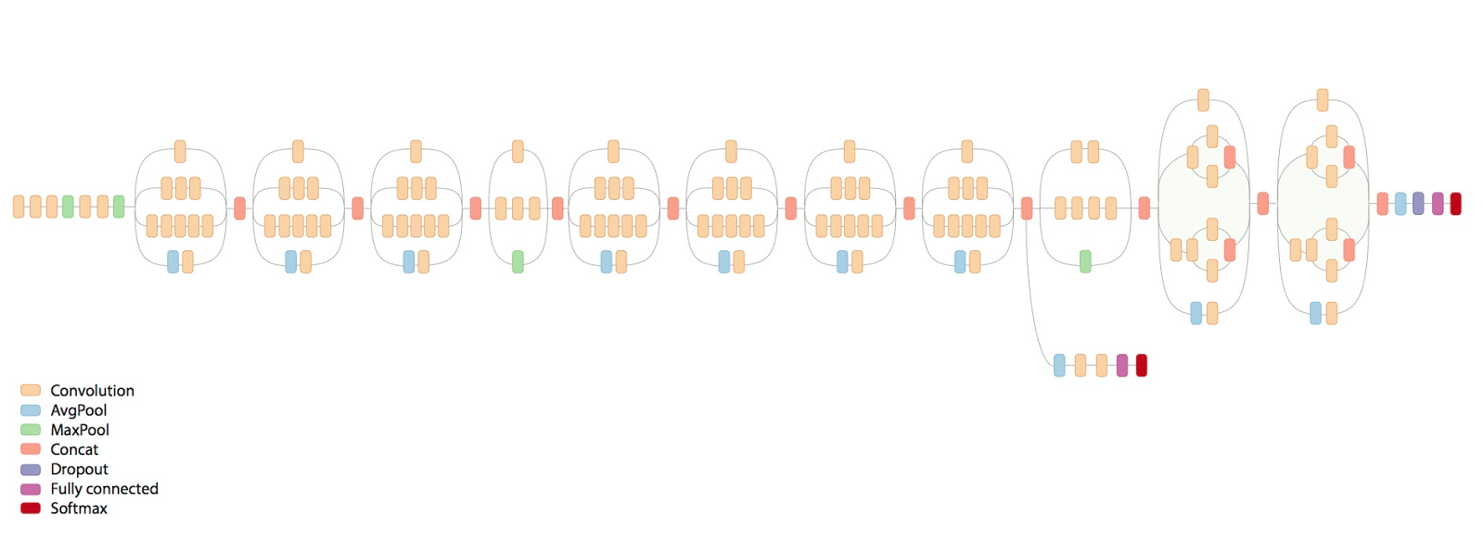
Inception Resnet V2
Released in 2016 by Google
Removes redundant correlation
Performs well under strict constraints of memory and time
Difficult to adapt to new cases
Faster than VGG even if is much deeper
Better accuracy than VGG

Slide 6
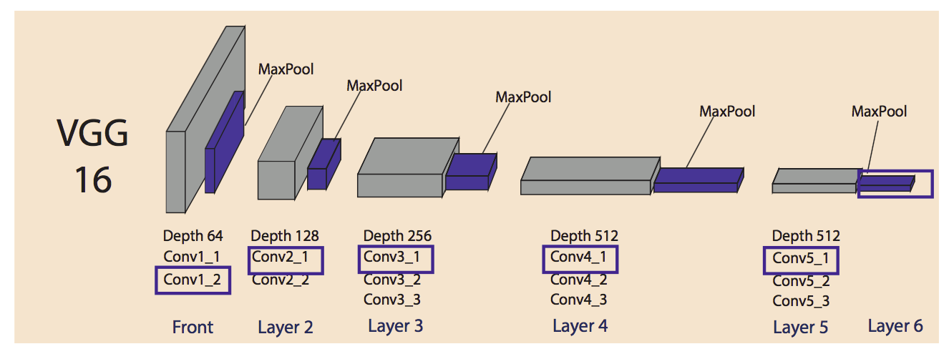
VGG-16
Characterized by its simplicity: 16 3x3 convolutional layers, 2 fully connected layer
Slow to train
Large weights
Most preferred choice in the community for extracting features

Slide 7
Basic NN
Standard neural networks for image recognition
Based on Keras libraries

Slide 8
Dataset
109 SVS images of 27 different patients
Dimension of 240x240 pixel
Second level of resolution for best quality and performances
Overlap of 50 pixels

Slide 9
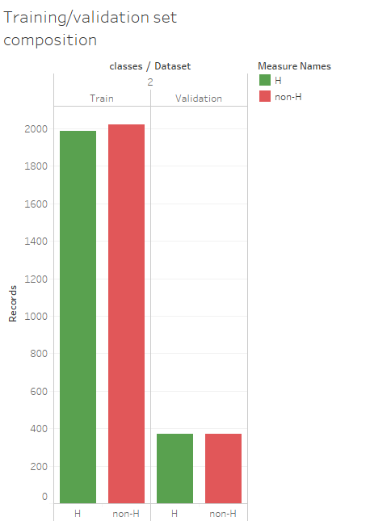
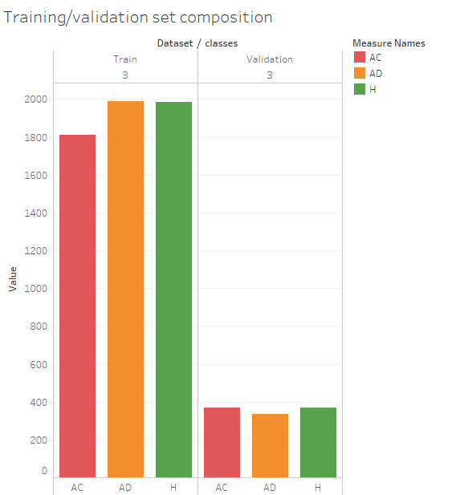
Training and Validation set
Division of dataset in training and test, balancing the numbers of element in the two sets, for the two types of classification
Validation set with 3 patients with 1073 crops, which is 15% of the total
Figura 2:composition of training and validation set with two classes.
Figura 2: composition of training and validation set with three classes

Slide 10
Code Implementation
Prediction script
Crop slides script
Color crop script
Combine slide script
Training script

Slide 11
Code Implementation - Main
Set crops dimension, crop overlap and level of resolution
Function ‘get prediction index’: convert from class name to the corresponding index in the prediction array
Function ‘get model’: retrieve requested model from the available repository and loads it
Function ‘create attention map’: loads images from the folder, creates a .txt file where to save the prediction results, saves the original slide and makes a copy of it, which gets cropped, classified and colored, before recreating the original image with all the crops

Slide 12
Code Implementation – Crop Slides
Set crops dimension
Set level of resolution, referring to the level 0
Crops the image considering as offset the top left pixel in the level 0 reference frame
Returns an RGBA image containing the contents of the specified region

Slide 13
Code Implementation- Color Crops
Function ‘evaluate prediction’: computes the alpha value of the red mask to apply to the image slice, based on the value of the prediction
Function ‘apply overlay’: applies colored overlay to an image according to its prediction value

Slide 14
Code Implementation – Combine Crops
Function ‘combine image’: recombine the original image from its fragments, given as input the previous image, the new fragment to add and the offset on the two axes referred to the original image

Slide 15
Code Implementation – Combine Crops
Function ‘combine image’: recombine the original image from its fragments, given as input the previous image, the new fragment to add and the offset on the two axes referred to the original image

Slide 16
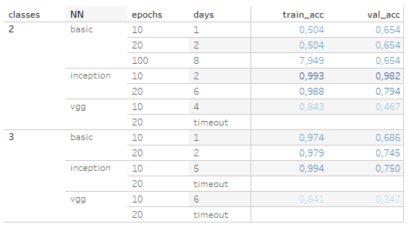
Training
Training and validation accuracy
Figura 5:Accuracy of models trained on the balanced dataset.

Slide 17
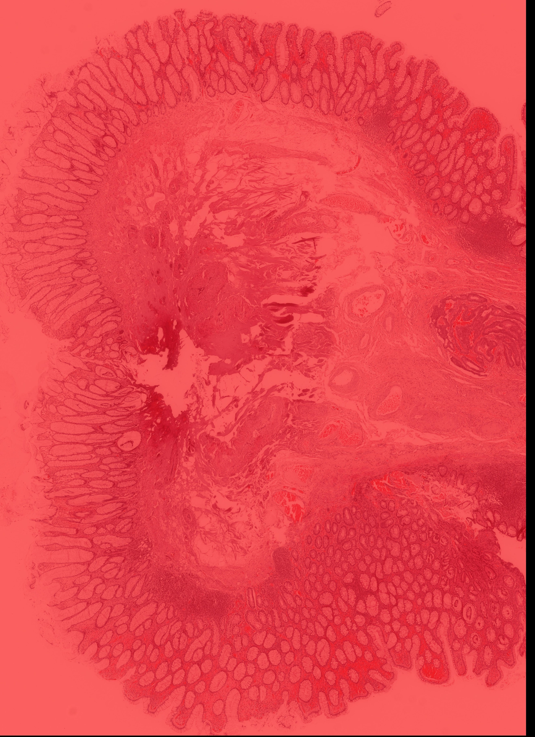
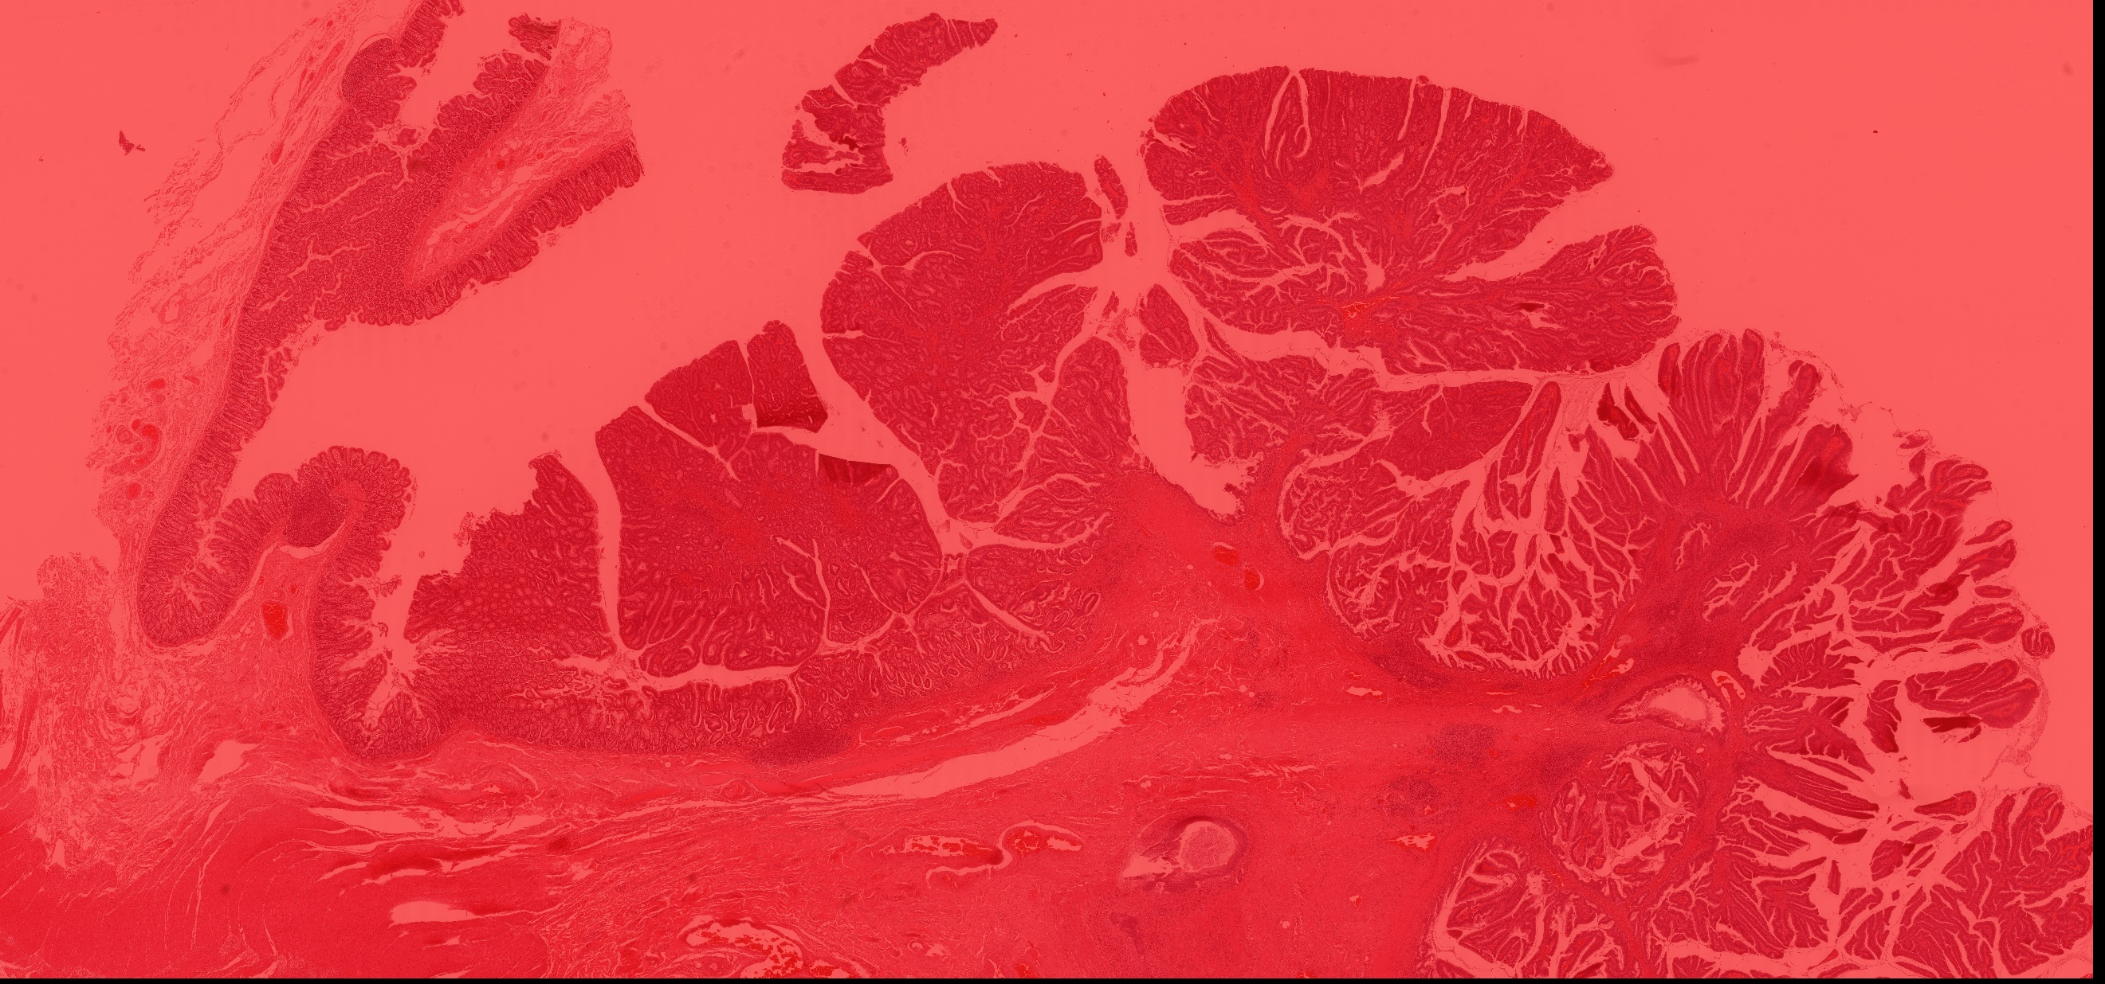
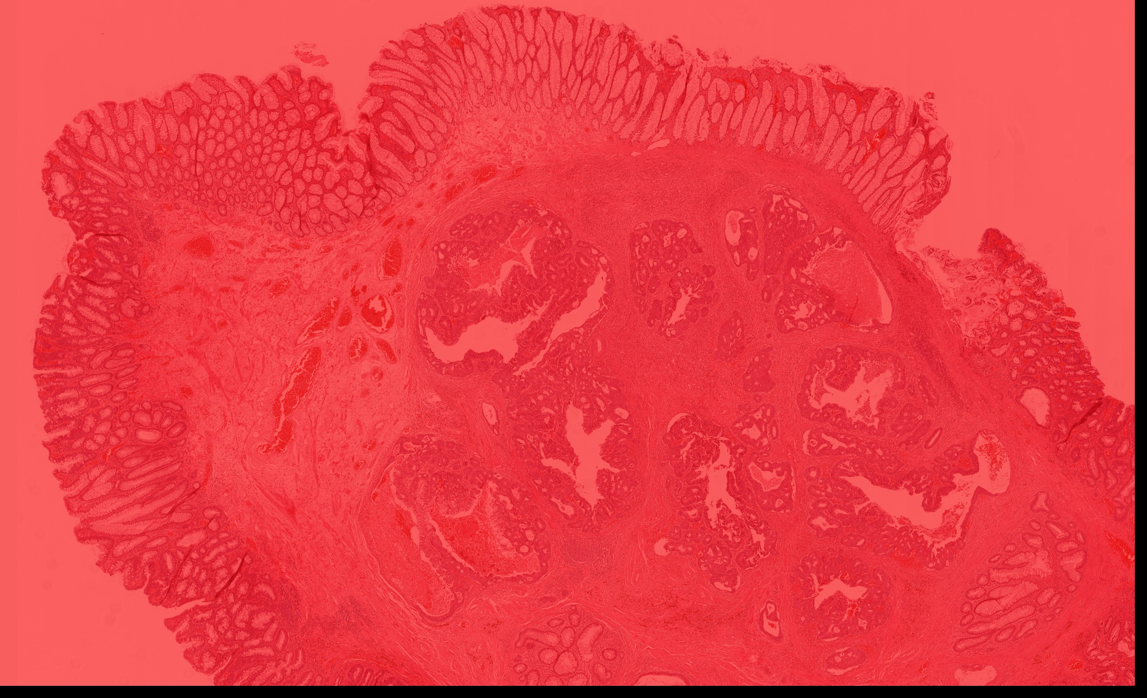
Attention Map
Recreates the whole image based on the previous classification of single crops
Results from networks trained in 2 classes:
Everything is classified as non-H
All test images are predicted as non-H

Slide 18
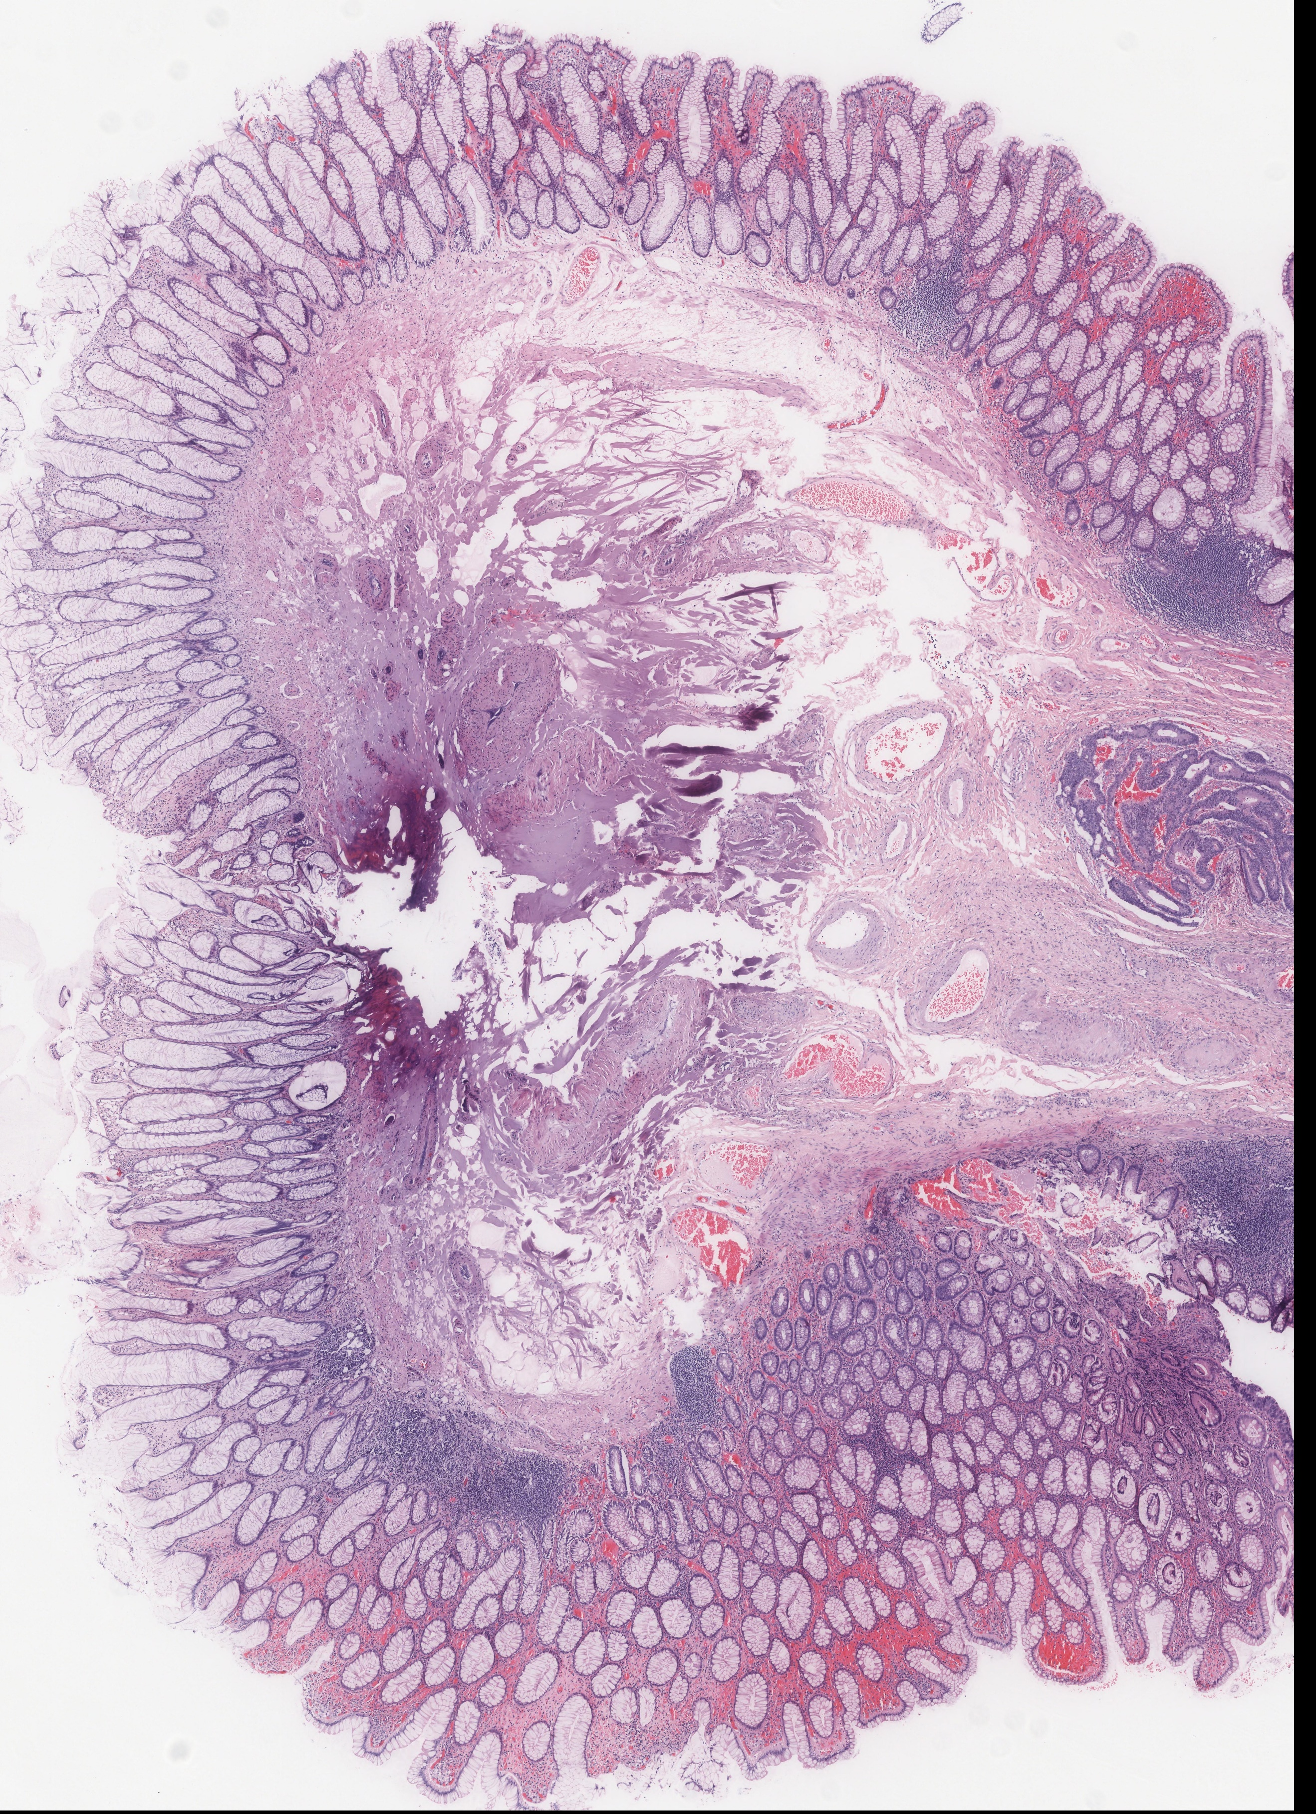
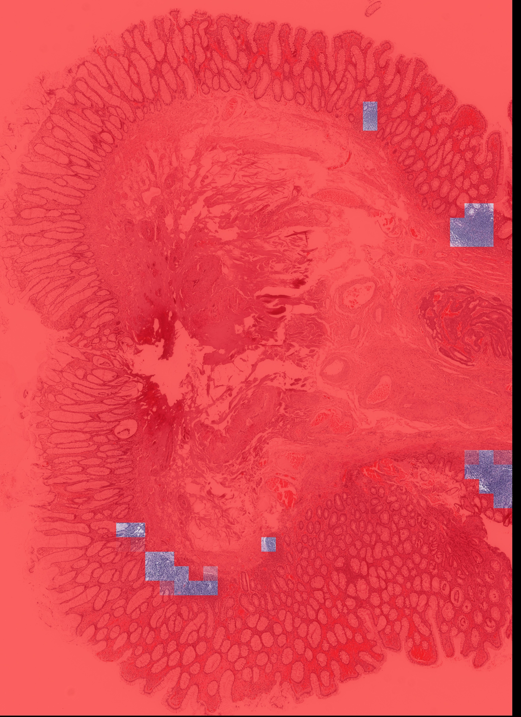
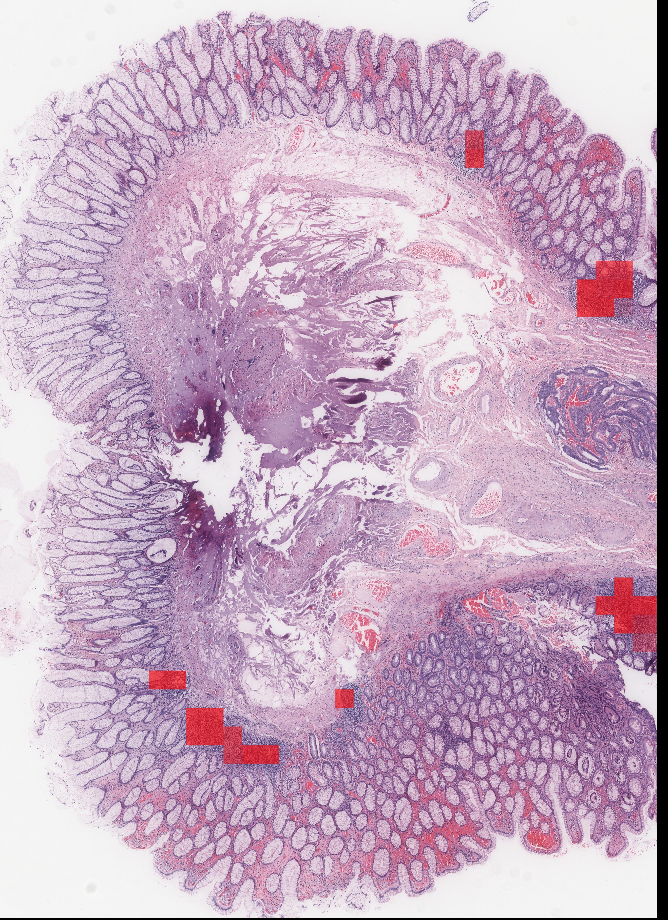
Attention Map
Recreates the whole image based on the previous classification of single crops
Results from networks trained on 3 classes are bad as the ones on 3 classes:
Basic-NN classifies everything as AD
InceptionResNetV2 classifies everything as AC
Vgg-16 classifies everything as AD
Attention map from vgg-16 prediction. Target class AC on the left, AD in the middle and H on the right.

Slide 19
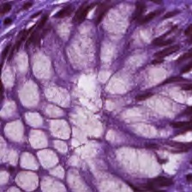
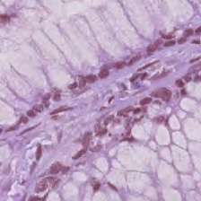
Difficulties
Difference in the crops of different patients in the same class
Low number of training epochs
Limited time for training
Class imbalance
Figura 10: Healthy cells of patient n.20 on the left and patient n.48 on the right.

Slide 20
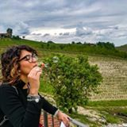
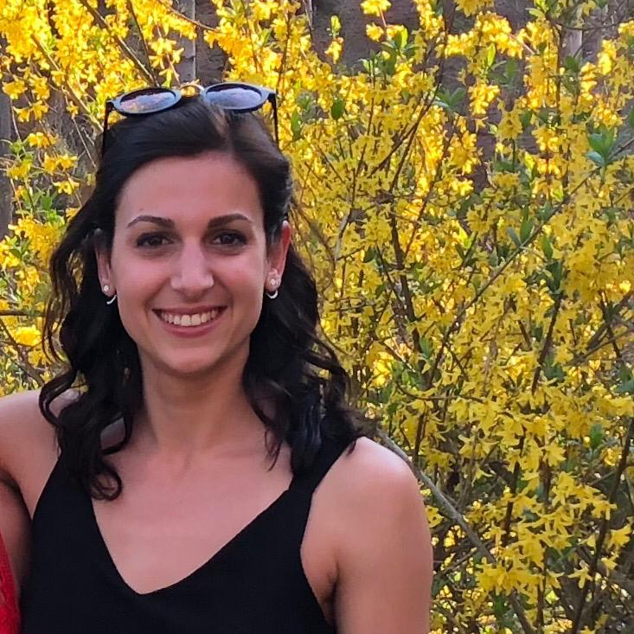


Team
Greta Berardengo
Biomedical engineer
Role: domain expert, data analyst
Silvia Fornara
Biomedical engineer
Role: domain expert, team manager
Andrea Grippi
Computer engineer
Role: developer, machine learning expert
Elisa Wan
Computer engineer
Role: software designer, developer, project manager
The team, has been able to work together, background differences have been exploited to get the most out of each other.

